Slide 1

Medical Report Generation and Validation System
NAME | ROLL NO | USN
Naveen Rajdev | 129 | 01FE23BCI061
Pooja P | 222 | 01FE23BCI058
Vikneshwaran Marimuthu | 223 | 01FE23BCI060
Vaishnavi Pagad | 225 | 01FE23BCI063
Guided By : Prashant Narayankar

Slide 2
Introduction
Medical report generation from images like X-rays and MRI is a complex and time-consuming task. Recent advances in deep learning and NLP enable automatic report generation using CNNs and Transformers. However, existing systems often lack proper validation and may produce clinically incorrect reports. This project focuses on generating and validating medical reports to improve accuracy and reliability.

Slide 3
Background
Recent advances in computer vision and Natural Language Processing (NLP) have enabled automatic medical report generation using models such as CNNs, Vision Transformers, and Transformers for extracting image features and generating text.
These systems achieve BLEU scores in the range of 0.59 to 0.77, indicating moderate to high performance in generating medical reports from images.
Advanced architectures combining CNNs and Transformers also achieve METEOR scores up to 0.74 and BERTScore around 0.78, demonstrating improved semantic understanding and contextual accuracy.
However, most existing systems focus mainly on report generation and lack proper validation and consistency checking, and studies show that current evaluation metrics like BLEU and ROUGE do not fully capture clinical correctness.

Slide 4
Motivation
Manual report generation is time-consuming and error-prone
Existing systems lack semantic validation
Need for accurate and verified report generation
Combine deep learning and NLP validation techniques
Aim to improve reliability and efficiency in healthcare

Slide 5
Objectives
Generate medical reports automatically from medical images
Use deep learning models (CNN/Transformer) for feature extraction and text generation
Validate reports using NLP techniques (BERT, n-grams, TF-IDF)
Detect errors and ensure clinical correctness
Improve efficiency and support healthcare professionals

Slide 6
Literature Survey

Slide 7
Literature Survey
AUTHORS | TITLE | METHODOLOGY | DATASET | RESULTS
Zaher Baber, Twan van Laarhoven, Fabio Massimo Zanzotto, Elena Marchiori (2021) | Evaluating Diagnostic Content of AI-Generated Radiology Reports of Chest X-rays | CNN encoder extracts visual features from chest X-ray images RNN/Transformer generates medical reports Introduces Diagnostic Content Score (DCS) for evaluation Uses word-based and sentence-based encoding with probabilistic scoring | Chest X-ray dataset with radiology reports Contains image-report pairs with diagnostic tags Includes both normal and abnormal cases for evaluation | Traditional metrics (BLEU, ROUGE) fail to capture clinical correctness Proposed DCS metric better evaluates diagnostic accuracy Generated reports are fluent but often miss key abnormalities Shows weak correlation between text similarity and medical correctness

Slide 8
Literature Survey
AUTHORS | TITLE | METHODOLOGY | DATASET | RESULTS
Eun Kyoung Hong, Jiyeon Ham, Byungseok Roh, et al. (2025) | Diagnostic Accuracy and Clinical Value of a Domain-specific Multimodal Generative AI Model for Chest Radiograph Report Generation | Developed a domain-specific multimodal generative AI model (image + text) Uses image encoder + transformer encoder + classification head to detect abnormalities Report generated using transformer decoder conditioned on image features and findings Evaluation includes: Detection accuracy (13 clinical findings) Report quality (acceptability, agreement, ranking) Uses BERT-based labeling (CheXbert) + GPT-4 pseudo-labeling for annotation | Training: ~8.8 million radiograph-report pairs from 42 hospitals (2005–2023) Test: 2145 radiographs (private + public datasets: PadChest, Open-i, VinDr-CXR, MIMIC-CXR) Multi-source, multi-country dataset with diverse cases | High sensitivity for critical findings: Pneumothorax: 95.3% Subcutaneous emphysema: 92.6% Report acceptance rate: 70.5% (close to radiologists 73.3%) Highest agreement & quality scores among compared models Ranked best in 60% cases vs radiologists & GPT-4Vision Still shows errors like hallucinations and missed findings

Slide 9
Literature Survey
AUTHORS | TITLE | METHODOLOGY | DATASET | RESULTS
Sayeh Gholipour Picha, Dawood Al Chanti, Alice Caplier (2024) | Semantic Textual Similarity Assessment in Chest X-ray Reports Using a Domain-Specific Cosine-Based Metric | Proposes Medical Corpus Similarity Evaluation (MCSE) metric Uses clinical entity extraction (SciSpacy) from reports Applies BERT-based embeddings + cosine similarity for semantic comparison Considers negations and descriptive context of medical entities Two-step process: Entity Extraction Domain Semantic Similarity Calculation | Uses MIMIC-CXR dataset (chest X-ray reports + labels) Uses RadGraph dataset for entity validation Evaluates on outputs from state-of-the-art models (R2Gen, CXR-RePaiR) | MCSE provides more meaningful semantic evaluation than BLEU Example: BLEU ≈ 0 vs MCSE ≈ 0.64 for similar reports Achieves ~75–76% accuracy in entity extraction validation Better captures clinical meaning and context similarity Limitation: bias in cosine similarity within same medical domain

Slide 10
Literature Survey
AUTHORS | TITLE | METHODOLOGY | DATASET | RESULTS
Luke T. Slater, Sophie Russell, Silver Makepeace, et al. (2022) | Evaluating Semantic Similarity Methods for Comparison of Text-Derived Phenotype Profiles | Extracts phenotype profiles from clinical text using NLP (HPO terms) Applies ontology-based semantic similarity measures (pairwise + groupwise methods) Evaluates 300 combinations of similarity techniques using SML toolkit Uses metrics: AUC, Mean Reciprocal Rank (MRR), Top-10 Accuracy | MIMIC-III clinical dataset (~60,000 ICU admissions) Sample: 1000 patient admissions with clinical text Phenotype profiles generated from text-derived annotations | Most methods show low AUC (~0.5–0.6), near random performance Best methods achieve AUC up to ~0.81 AVG and GIC similarity methods perform best Embedding methods show moderate performance Limitation: performance varies widely; no single optimal method

Slide 11
Literature Survey
AUTHORS | TITLE | METHODOLOGY | DATASET | RESULTS
Fei Dong, Shouping Nie, Manling Chen, Fangfang Xu, Qian Li (2025) | Keyword-based AI Assistance in the Generation of Radiology Reports: A Pilot Study | Proposes human-AI collaborative approach using keyword inputs Radiologists provide structured keyword reports Uses LLM (DeepSeek) to generate full reports via prompt engineering Includes template-based prompting, examples, and exception handling Evaluates report quality using Likert scoring and diagnostic accuracy | 100 patients with intracranial tumors (MRI data) Reports written by 2 radiology residents Includes: Routine reports Keyword-based reports Validation with senior radiologists + second LLM evaluation | Reporting time reduced by ~28% Diagnostic accuracy: 68% (Resident 1), 76% (Resident 2) Report quality comparable to human reports (no significant difference) Limitations: Small dataset Depends on keyword quality Risk of LLM hallucinations and inaccuracies

Slide 12
Literature Survey
AUTHORS | TITLE | METHODOLOGY | DATASET | RESULTS
Benjamin Clay, Henry I. Bergman, Safa Salim, Gabriele Pergola, Joseph Shalhoub, Alun H. Davies (2025) | Natural Language Processing Techniques Applied to Electronic Health Records in Clinical Research and Practice | Describes full NLP pipeline for EHR analysis Includes text preprocessing (tokenization, stopword removal, lemmatization) Covers statistical methods (BoW, TF-IDF) and ANN-based methods (Word2Vec, BERT, LLMs) Uses techniques like Named Entity Recognition (NER), classification, prediction, and embedding-based similarity Combines structured + unstructured data for clinical analysis | Uses Electronic Health Records (EHR) datasets Includes clinical notes, reports, patient history, and structured data References datasets like i2b2, MIMIC-III, PubMed corpora for training and evaluation | ANN-based methods (especially BERT, LLMs) outperform traditional statistical methods Achieves high accuracy (>99%) in tasks like anonymization Demonstrates strong performance in: - Information extraction -Clinical prediction Limitations: -Black-box nature (low explainability) -Risk of hallucination in LLMs -Data privacy and regulatory challenges

Slide 13
Literature Survey
AUTHORS | TITLE | METHODOLOGY | DATASET | RESULTS
Pablo Messina, Pablo Pino, Denis Parra, Alvaro Soto, Cecilia Besa, Sergio Uribe, et al. (2022) | A Survey on Deep Learning and Explainability for Automatic Report Generation from Medical Images | Most systems follow CNN (visual encoder) + RNN/LSTM/Transformer (language model) architecture Incorporates attention mechanisms for better alignment between image regions and text Explores template-based, generative, and hybrid approaches for report generation Includes explainability techniques such as attention maps, Grad-CAM, and heatmaps Evaluates use of auxiliary tasks (classification, segmentation) to improve performance | Reviews multiple datasets such as: - IU X-ray (7,470 images, 3,955 reports) - MIMIC-CXR (~377k images, 227k reports) - PadChest (~160k images) Includes both report datasets and classification datasets (CheXpert, ChestX-ray14) Covers various modalities: X-ray, CT, MRI, ultrasound, retinal images | CNN + RNN/Transformer is the most common and effective architecture Attention mechanisms improve report quality and interpretability Auxiliary tasks enhance feature extraction and model performance Major limitation: evaluation metrics (BLEU, ROUGE) are weak and do not capture medical correctness Highlights need for better validation and explainability in medical report generation systems

Slide 14
Literature Survey
AUTHORS | TITLE | METHODOLOGY | DATASET | RESULTS
Eui Jin Hwang, Jong Hyuk Lee, Woo Hyeon Lim, Won Gi Jeong, Wonju Hong, Jongsoo Park, Seung-Jin Yoo, Hyungjin Kim (2025) | Clinical Validation of a Generative Artificial Intelligence Model for Chest Radiograph Reporting: A Multicohort Study | Developed a generative AI model for automatic chest X-ray report generation Applied model on real-world clinical data across multiple cohorts (ICU, emergency, health checkups) Reports evaluated by panel of expert thoracic radiologists Compared AI-generated reports with radiologist-written reports Evaluation metrics include: - Clinical acceptability (standard & strict criteria) - Sensitivity & specificity for abnormality detection | 1539 chest radiographs from multiple clinical settings Data collected from: - ICU - Emergency department - Health checkups - Public datasets Multi-cohort dataset ensures diverse real-world scenarios | AI-generated reports achieved high clinical acceptability (~87–91%) Comparable to radiologists under standard criteria Slightly lower performance under strict evaluation criteria Demonstrated strong ability in detecting referable abnormalities However, still requires human oversight due to occasional errors and limitations

Slide 15
Research Gaps Identified
Most existing systems focus on generating reports, but do not ensure if the report is actually clinically correct
Common evaluation metrics like BLEU and ROUGE only compare text, not medical meaning
Semantic validation techniques exist, but they are not integrated into the actual system pipeline
No system combines both keyword-based checks and semantic understanding together
There is no complete system that goes from image → report → report validation
Models struggle to understand context and negation, which is critical in medical reports
Final reports still require human verification, limiting full automation

Slide 16
Problem Statement
Design and develop a deep learning-based system to automatically generate medical reports from medical images (X-rays) and validate their semantic correctness using NLP techniques.
The system should utilize multimodal deep learning models for accurate report generation and implement a verification module using BERT-based semantic similarity and n-gram analysis to ensure consistency, detect errors, and validate the clinical meaning of generated reports.

Slide 17
Requirement Analysis
Functional Requirements
Accept medical images (X-rays) as input
Preprocess images (resize, normalize)
Extract image features using CNN / Vision Transformer
Generate medical reports using Transformer/LSTM model
Perform text preprocessing (tokenization, cleaning)
Validate generated reports using:
i) BERT-based semantic similarity
ii) N-gram and TF-IDF analysis
Detect missing or incorrect medical terms
Compare generated report with reference report
Display final validated report with accuracy metrics

Slide 18
Requirement Analysis
Non-Functional Requirements
Accuracy: High clinical correctness in generated reports
Performance: Fast report generation and validation
Scalability: Handle large medical datasets efficiently
Reliability: Consistent and error-free outputs
Usability: Simple and user-friendly interface
Security & Privacy: Protect sensitive patient data
Maintainability: Easy to update models and system
Compatibility: Works with standard datasets and systems
Availability: System should be accessible when needed

Slide 19
Proposed Plan
The proposed system consists of three main components, namely image analysis, report generation, and report validation.
In the first stage, image features are extracted from medical images using deep learning models such as Convolutional Neural Networks (CNN) or Vision Transformers (ViT).
In the next stage, a Transformer-based model is used to generate a medical report by converting the extracted image features into meaningful textual descriptions.
In the final stage, a verification module is applied to validate the generated report using Natural Language Processing (NLP) techniques such as n-grams, semantic similarity, and medical terminology checking.
The system is trained and evaluated using medical image datasets along with standard evaluation metrics to measure its performance and accuracy

Slide 20
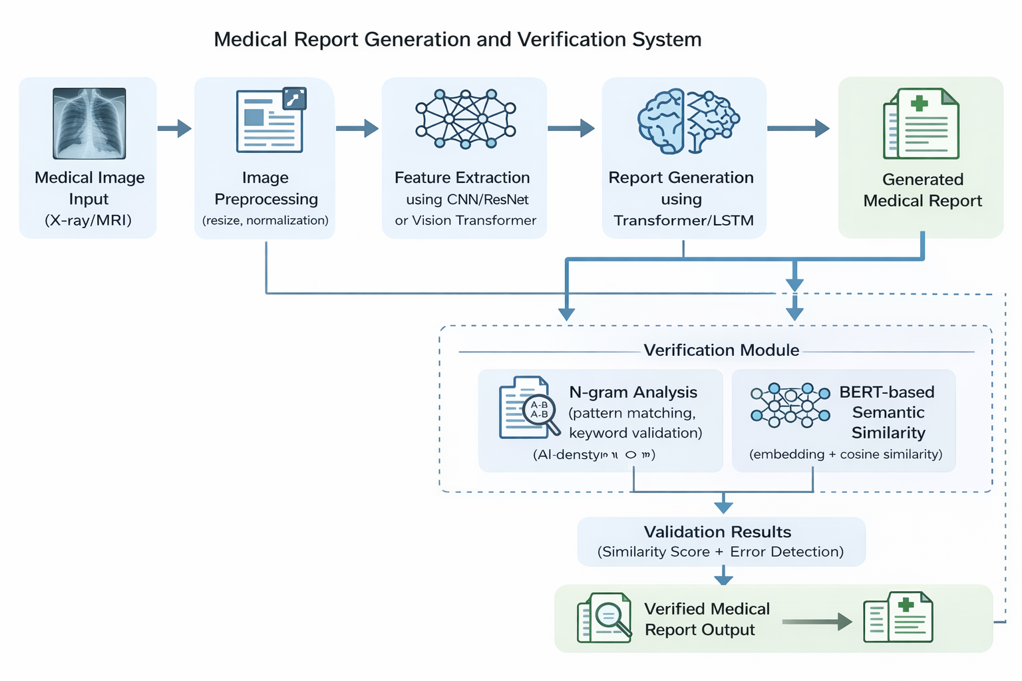
Proposed Architecture

Slide 21
Evaluation Metrics & KPIs
Semantic Validation (Primary Metric)
BERT-based Cosine Similarity
Valid Report: > 0.75
Measures clinical meaning and correctness
Keyword Validation
N-gram + TF-IDF Analysis
Accuracy: 80% – 90%
Detects missing or incorrect medical terms
Diagnostic Alignment
Accuracy: 70% – 85%
Measures match between generated and actual findings

Slide 22
Task Identification
Modules / Tasks
Data Preprocessing
Image normalization, resizing
Text preprocessing (tokenization, stopword removal, lemmatization)
Image Feature Extraction
CNN (ResNet) / Vision Transformer
Report Generation
LSTM / Transformer-based sequence model
Report Verification (Core Module)
n-gram extraction
TF-IDF vectorization
Cosine similarity computation
Embedding-based similarity (Word2Vec/BERT)
Evaluation Module
BERT-based Cosine Similarity and accuracy metrics
Integration & Interface

Slide 23
Applicability in the Societal Context
1. Healthcare Accessibility: Automated report generation reduces dependency on specialist radiologists, making diagnostic services accessible in remote and underserved regions where expert radiologists are scarce. 2. Reduced Diagnostic Delays: The system can generate and validate reports rapidly, cutting turnaround time for patients and enabling faster clinical decision-making in emergency scenarios. 3. Radiologist Support: Acts as a second-opinion tool that assists radiologists by flagging inconsistencies and highlighting regions of concern, reducing human error and cognitive fatigue. 4. Cost Reduction: Automating report generation lowers the cost of diagnostic services, making quality healthcare more affordable for lower-income populations.

Slide 24
Applicability in the Societal Context
5. Improved Patient Outcomes: More accurate and consistent reports lead to better diagnoses, timely treatment, and improved patient outcomes especially for diseases like pneumonia, tuberculosis, and cancer detectable via imaging. 6. Scalability in Public Health: During health crises or mass screening programs, the system can process large volumes of medical images efficiently without proportional increase in human workforce. 7. Educational Value: The system can serve as a training tool for medical students and junior radiologists by providing structured, validated reports as reference examples.

Slide 25
Thank you

